Slide 1
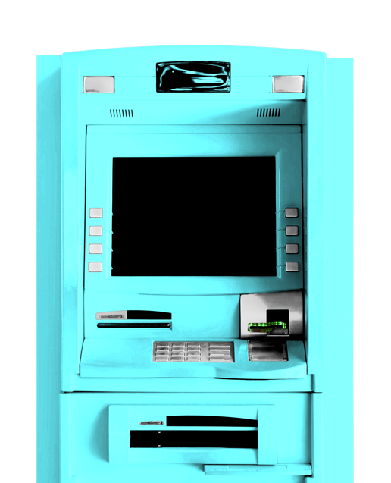
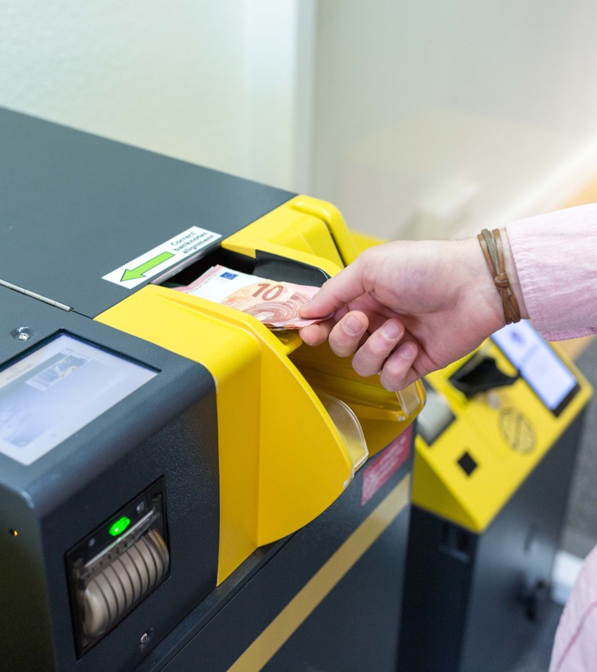

Digitalizing your Cash
Prosegur Cash Today.
Día / Mes / Año

Slide 2
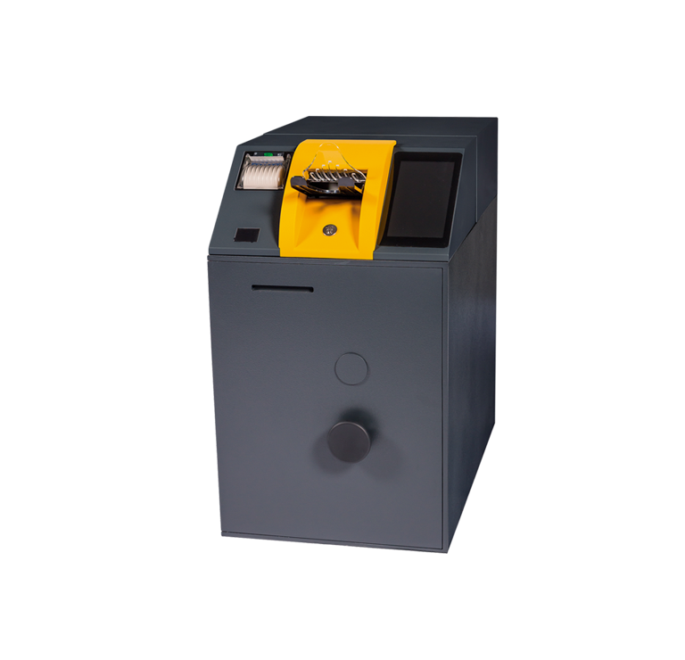
01 Cash Today Solutions.
02 Prosegur Cash Today.
03 Value proposition.
04 Successful cases.
05 Clients’ opinions.
Index

Slide 3

Prosegur Cash Today.
1. Cash Today Solutions.

Slide 4


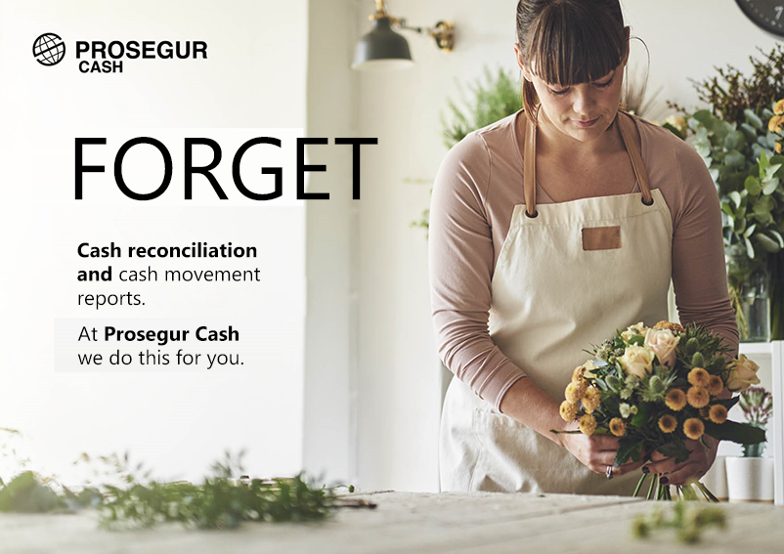

01. Cash Today Solutions.
Prosegur Cash Today.

Slide 5




01. Cash Today Solutions. Cash Today optimizes.
Prosegur Cash Today.
OPTIMIZES
Cash Today
Improved operating times at end-of-day close: faster counting, validation and balancing.
Improved traceability of cash in business.
Change delivery service.
Avoiding the sidewalk risk while transporting cash
to the bank.
Avoidance of waiting times at the bank branch.
Reduction of cost of immobilised cash in your business.
Gestión de redes
Corresponsales

Slide 6
01. Cash Today Solutions. Cash Today deposit benefits.
Prosegur Cash Today.
Efficient
cash
management
Faster end-of-day close.
Possibility of recording the transaction in the customer's bank account the day after it is deposited.
Decreases cash counting time.
Greater
security
Reduction of sidewalk risk and transportation times to the bank branch.
Greater traceability of the cash from the time it is deposited into Cash Today solutions.
Increased focus on business
Cash movements are available online.
Possibility of recording cash transactions in customer's account the day after it is deposited.
Less time spent on cash control, end-of-day closes and monthly cash balances.

Slide 7
01. Cash Today Solutions. How does it work?
Prosegur Cash Today.
Cash Today:
Deposit your daily cash incomes.
Transport:
Prosegur will collect the cash deposited into Cash Today solutions.
Online information:
See the cash transactions on our Cash Today website.
Same Day Value
Service:
Your daily cash incomes will be automatically available in your bank account.

Slide 8
Prosegur Cash Today.
2. Prosegur Cash Today.

Slide 9
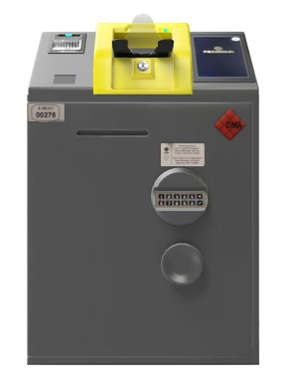
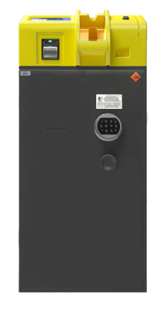
02. Prosegur Cash Today. Machine suite.
Banknote deposit machine.
Prosegur Cash Today.
LOW VOLUME BANKNOTE
DEPOSIT MACHINE SDM100
Capacity of 2,500 banknotes.
Speed of deposit machine:
1.5 banknotes/second.
Dimensions:
455 x 690 x 734 mm.
Weight: 336kg.
BANKNOTE DEPOSIT
MACHINE SDM500
Capacity of 9,000 banknotes.
Deposit machine speed:
3 banknotes/second.
Dimensions:
455 x 685 x 1035 mm.
Weight: 425kg.

Slide 10
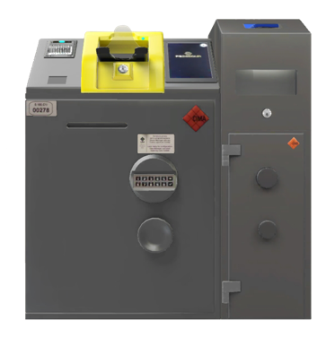
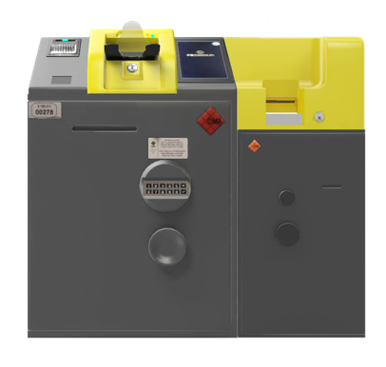
02. Prosegur Cash Today. Machine suite.
Banknote and coin deposit machine.
Prosegur Cash Today.
BANKNOTE AND COIN DEPOSIT MACHINE
SDM100 - CDS508
Capacity:
2,500 banknotes.
Speed of deposit machine:
1.5 banknotes/second
Dimensions
679 x 690 x 760 mm.
Weight: 362.16 kg.
BANKNOTE AND COIN DEPOSIT MACHINE
SDM100 - CDS801
Capacity:
2,500 banknotes.
Speed of deposit machine:
1.5 banknotes/second
Dimensions
879 x 690 x 1045 mm.
Weight: 466kg.
Capacity:
2,250 coins.
Speed of deposit machine:
3 coins/second.
Capacity:
4,500 coins.
Speed of deposit machine:
15 coins/second.

Slide 11
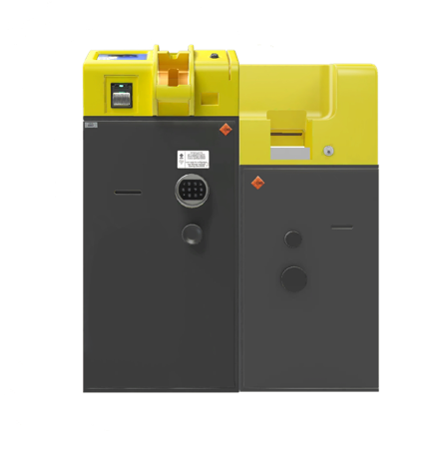
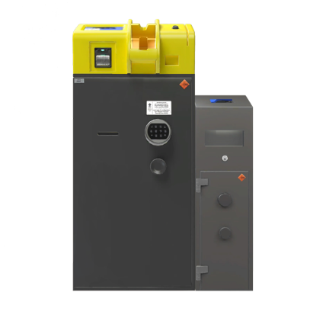
02. Prosegur Cash Today. Machine suite.
Banknote and coin deposit machine.
Prosegur Cash Today.
BANKNOTE AND COIN DEPOSIT MACHINE
SDM500 - CDS508
Capacity:
9,000 banknotes.
Speed of deposit machine:
3 banknotes/second
Dimensions
679 x 685 x 1035 mm.
Weight: 451.16 kg.
BANKNOTE AND COIN DEPOSIT MACHINE
SDM500 - CDS801
Capacity:
9,000 banknotes.
Speed of deposit machine:
3 banknotes/second
Dimensions
879 x 685 x 1045 mm.
Weight: 545 kg.
Capacity:
2,250 coins.
Speed of deposit machine:
3 coins/second.
Capacity:
4,500 coins.
Speed of deposit machine:
15 coins/second.

Slide 12
Prosegur Cash Today.
3. Value proposition.

Slide 13
















03. Value proposition. Monthly fee.
Cash Today.
RENTAL
CASH TODAY SERVICES INCLUDED
Machine
model
Stop
Banknote
Monthly payment*
€/month
Coin
Change
Bags
*Monthly payment (services included in the purchase or rental of the solution).
Solution according to selected option.
Transport and distribution.
Installation and commissioning,
no civil works included.
Router for 3G communications.
MIPROSEGUR website, from where you can:
View all movements.
Export data to Excel or CSV.
Banknote and coin emptying bags/box, depending on selected option.
User training.
User management software.
Sign up/remove users.
Updates:
Software (including new banknotes).
Maintenance:
Monitoring.
Help Desk from 9:00
to 23:00 from Monday to Sunday.
Manpower.
Technician displacements.
Spare parts.
5-year contract.
3G

Slide 14


03. Value proposition. Monthly fee.
Cash Today.
PURCHASE
CASH TODAY SERVICES INCLUDED
Machine
model
Stop
Banknote
Monthly payment*
€/ month
Coin
Change
Purchase Price*
Bags
* One-time payment
*Monthly payment (services included in the purchase or rental of the solution).
Solution according to selected option.
Transport and distribution.
Installation and commissioning,
no civil works included.
Router for 3G communications.
MIPROSEGUR website, from where you can:
View all movements.
Export data to Excel or CSV.
Banknote and coin emptying bags/box, depending on selected option.
User training.
User management software.
Sign up/remove users.
Updates:
Software (including new banknotes).
Maintenance:
Monitoring.
Help Desk from 9:00
to 23:00 from Monday to Sunday.
Manpower.
Technician displacements
Spare parts.
5-year contract.
3G

Slide 15
03. Value proposition. Variable Services.
Cash Today.
Stop
€ / unit
€
Banknote
€ / 10.000 €
€
Coin
€ / 10.000 €
€
Change
€ / 10.000 €
€
Bags
€ / 100 units
€

Slide 16
Prosegur Cash Today.
4. Successful cases.

Slide 17
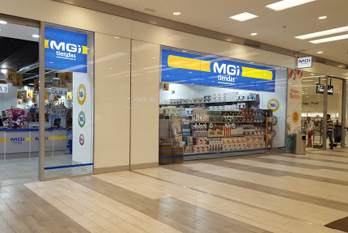

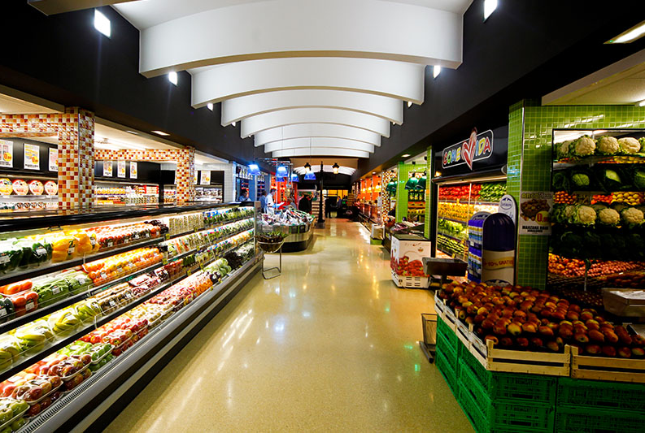
04. Success Cases.
Prosegur Cash Today.
MGI Store
Grosso Napoletano
El Arco

Slide 18
Prosegur Cash Today.
5. Clients’ opinions

Slide 19
05. Clients’ Opinions.
Prosegur Cash Today.
Tobacco Shops
Service stations
Thanks to Prosegur Cash, we now have the possibility of having an automatic cash deposit service in each of our establishments, which allows us to streamline all cash management processes and save time to devote to other more productive activities.
The management of Cash Today is very simple and fast, and its user-friendliness is a key point for us, as it avoids having to go out on the street carrying large amounts of money to be deposited in the bank. It does it automatically from our own business, which we highly value, like the closeness and know-how of the people behind Prosegur Cash.
Supermarkets
Store chain
Thanks to the Cash Today solution we can easily identify counterfeit bills, so we have the peace of mind of knowing that the money is real. It also allows us to make automatic deposits into our accounts without leaving the stores, which makes cash management and budget control much easier. Ultimately, we are very happy with Prosegur Cash.
Our experience with Prosegur Cash has been fully satisfactory. From the very first moment they understood our needs so they developed an ad-hoc service adjusted to our budget. They provide an outstanding service. This give us great peace of mind and allows us to have liquidity faster without having to go to the bank.
Lottery Shops
Hospitality
When you have several restaurants, it is essential to have a good organization for a smooth business management and a good customer service to make them loyal to your brand. That’s why I couldn’t be happier with the solution Prosegur Cash proposed to me for optimizing my business. With Cash Today, we have gained time and peace of mind, I have all the cash movements under control in my business and I receive the cash income in my bank account without having to go to the bank.
This service supossed a revolution in my business. Having a constant cash change is essential in our daily lives, but until today we used to waste a lot of time looking for it or going to the bank when we needed it. Thanks to Prosegur Cash we have cash change for the whole month without worries. The impact for us has been amazing.

Slide 20


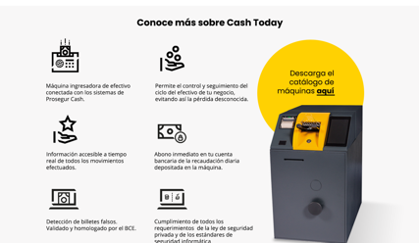
Web Cash Today

Slide 21
Thank you.

